Slide 1


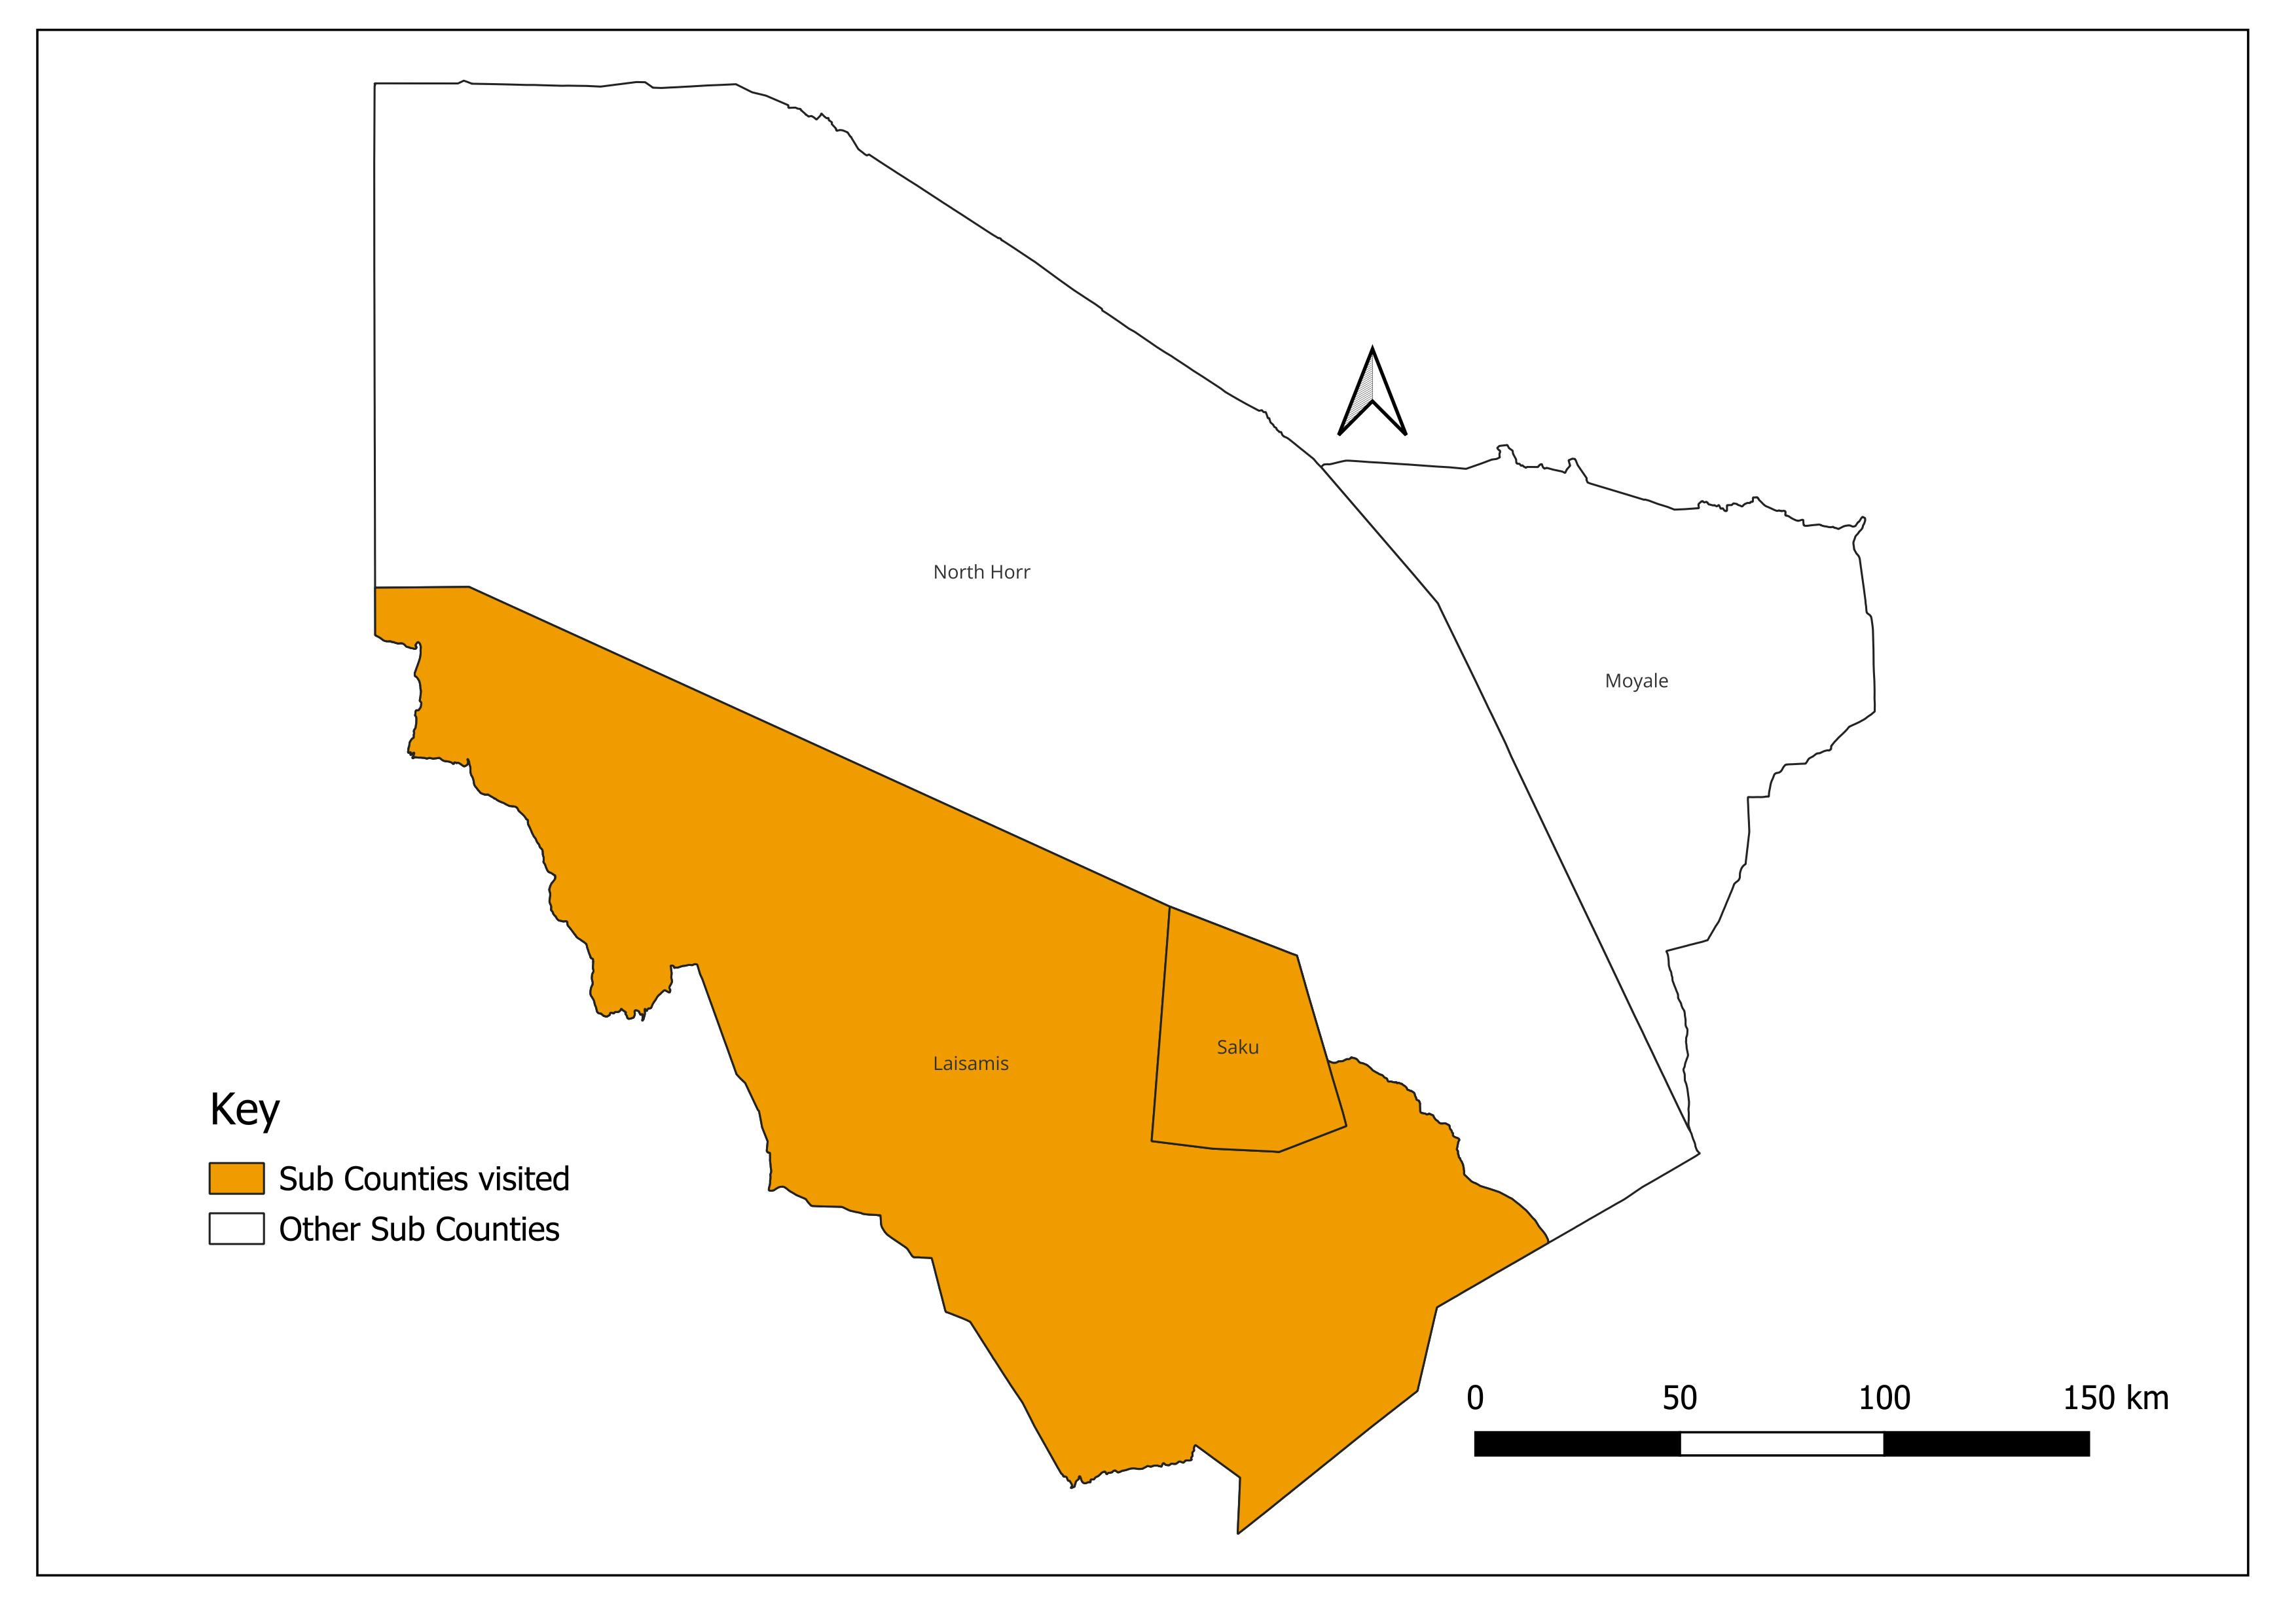
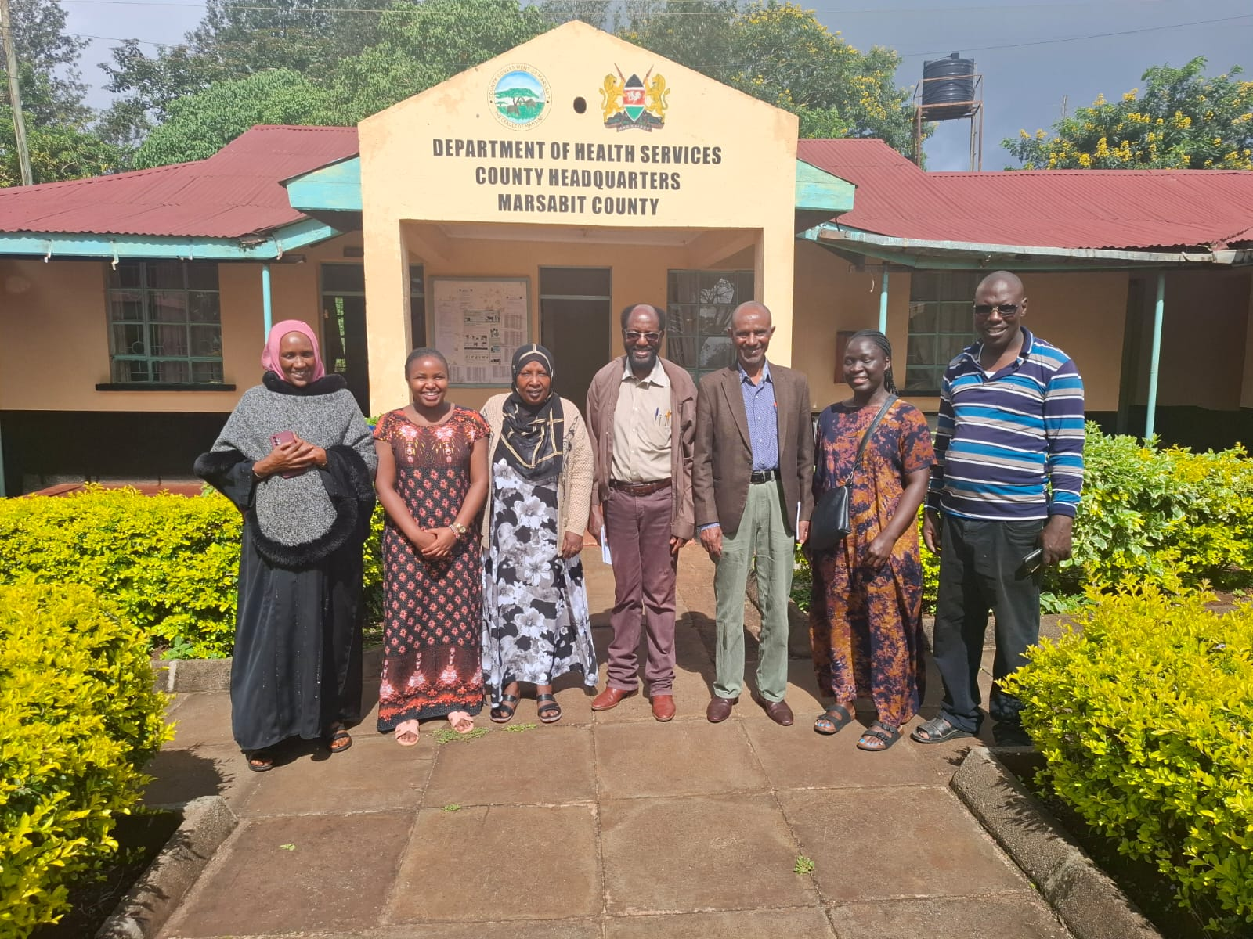


Verification and Validation of nOPV2 Vial Accountability Following Round 2 of the Polio Outbreak Response Supplementary Immunization Activity in Marsabit County, Kenya
Winnie Nyakado¹, Mercy Matui², Peter King’ori³, Prof. Patrick Kenya³
¹National Vaccines and Immunization Program, Ministry of Health Kenya²Public Health Emergency Operations Centre (PHEOC), Ministry of Health Kenya³National Task Force (NTF)
BACKGROUND
Following a polio outbreak response campaign in Marsabit County, Kenya, a verification and validation exercise was conducted in May 2025. This was in line with Global Polio Eradication Initiative (GPEI) guidelines to ensure strict accountability for all Potentially Infectious Materials (PIMs), specifically novel Oral Polio Vaccine type 2 (nOPV2) vials, after the second round of Supplementary Immunization Activities (SIA).
OBJECTIVE: To ensure that all nOPV2 vials used in SIA round two (R2) of the vDPV2 outbreak in Marsabit County are accounted for after the round two (R2) nOPV2 campaign by the nOPV2 global guidelines.
.
METHODOLOGY: The independent team conducted a field verification in Marsabit County, which was operationally divided into seven sub-counties. Using a random sampling method, two sub-counties (Saku and Laisamis) were selected. Within these, 16 out of 43 health facilities that participated in the SIA were visited for physical inspection and data validation against accountability forms.
STUDY AREA: Marsabit County, Kenya
STUDY DESIGN AND SAMPLING
Indicator | Result | Description
Target Population | 176,950 children | Children under 11 years targeted during Round 2 nOPV2 SIA in Marsabit County
Children Vaccinated | 156,278 | Total number of children vaccinated during the campaign
Vials Distributed | 1,740 | Total nOPV2 vaccine vials issued to the sampled sub-counties
Vials Returned | 1,740 | All usable and unusable vials were returned through reverse logistics
Vials Unaccounted For | 0 | No vaccine vial losses were reported
Usable Vials Returned | 556 | Unopened vials with valid VVM and expiry date
Unusable Vials Returned | 1,184 | Opened, empty, expired, or damaged vials
Sub-counties Verified | 2 of 7 (29%) | Saku and Laisamis sub-counties were sampled for verification
Facilities Visited | 16 of 43 (37%) | Health facilities visited for monitoring and validation
STATISTICAL ANALYSIS:The campaign successfully vaccinated 156,278 children. We sampled and visited 16/ 43(37.2%) facilities that participated in the SIA R2, in the selected sub-counties ,the verification confirmed that all 5,200 nOPV2 vials distributed for Round 2 were fully accounted for, with zero losses. All used, unused, usable, and unusable vials were successfully retrieved and returned. However, the exercise identified challenges, including inadequate documentation at some health facilities and the lack of a dedicated county vaccine depot.
RESULTS
DISCUSSION
Tables shows End of Round two (R2) nOPV2 distribution and utilization accountability in the two sub-counties sampled and visited
The verification exercise confirmed strong accountability of nOPV2 vaccine vials across operational levels in Marsabit County following Round 2 of the outbreak response SIA. Monitoring of 29% of sub-county depots and 37% of service delivery points demonstrated high compliance with GPEI containment and vaccine accountability guidelines. All usable and unusable nOPV2 vials were retrieved and returned through reverse logistics to the national level, indicating effective vaccine tracking mechanisms. However, gaps were observed in documentation practices at some health facilities, particularly incomplete ledger entries and unsigned VAM forms. Operational challenges such as lack of a county vaccine depot, limited storage space at sub-county depots, and difficult terrain affecting facility access were also noted
nOPV2 vials received and distributed at Round two (R2)
 | VIALS RECEIVED |  | VIALS RETURNED |  |  |  | PHYSICAL COUNT |  | Remark s
Name of Sub- County | # of usable vials *(1) receive d for R1 SIA | # of usable *(1) vials ADDED/ STOCKED | # of usable vials *(1) returned | # of unusable vials *(2) returned | # of total vials unaccounted d for at the end of SIA round (R1) | END BALANCE OF USABLE VIALS *(1) in stock | # of usable vials *(1) | # of unusable vials *(2) at the end of the SIA *(1)
A | B | C | D | E | F | G | H | I | J
Saku | 960 | 0 | 353 | 607 | 0 | 353 | 353 | 607
Liasamis | 780 | 0 | 203 | 577 | 0 | 203 | 203 | 577
Total | 1740 | 0 | 556 | 1184 | 0 | 556 | 556 | 1184
CONCLUSIONS
 | Adminis trative Level | Total # of Facilities Participa ting in SIA | # of Facilities | % of facilities monitor ed | # of facilities | % of facilities | # of facilities | % of facilities | # of facilities | % of facilities | Round Number: (2)
 | A | B | C | D = C/B % | E | F = E/C % | G | H | I | J
 | National | X | X | X | X | X | X | X | X | X
 | County | X | X | X | X | X | X | X | X | X
 | Sub-County Depots | 7 | 2 | 29% | 0 | 0 | 0 | 0 | 0 | 0
 | Service Delivery Points (fixed sites) | 43 | 16 | 37% | 0 | 0 | 0 | 0 | 0 | 0
The SIA Round 2 in Marsabit County was successful with complete vaccine accountability. It is concluded that the monitoring and validation processes were effective. To strengthen future campaigns, it is recommended to provide enhanced training for health facility staff on documentation and to establish a county-level vaccine storage depot to improve logistics.
Contact: mercymatui@gmail.com

